Slide 1

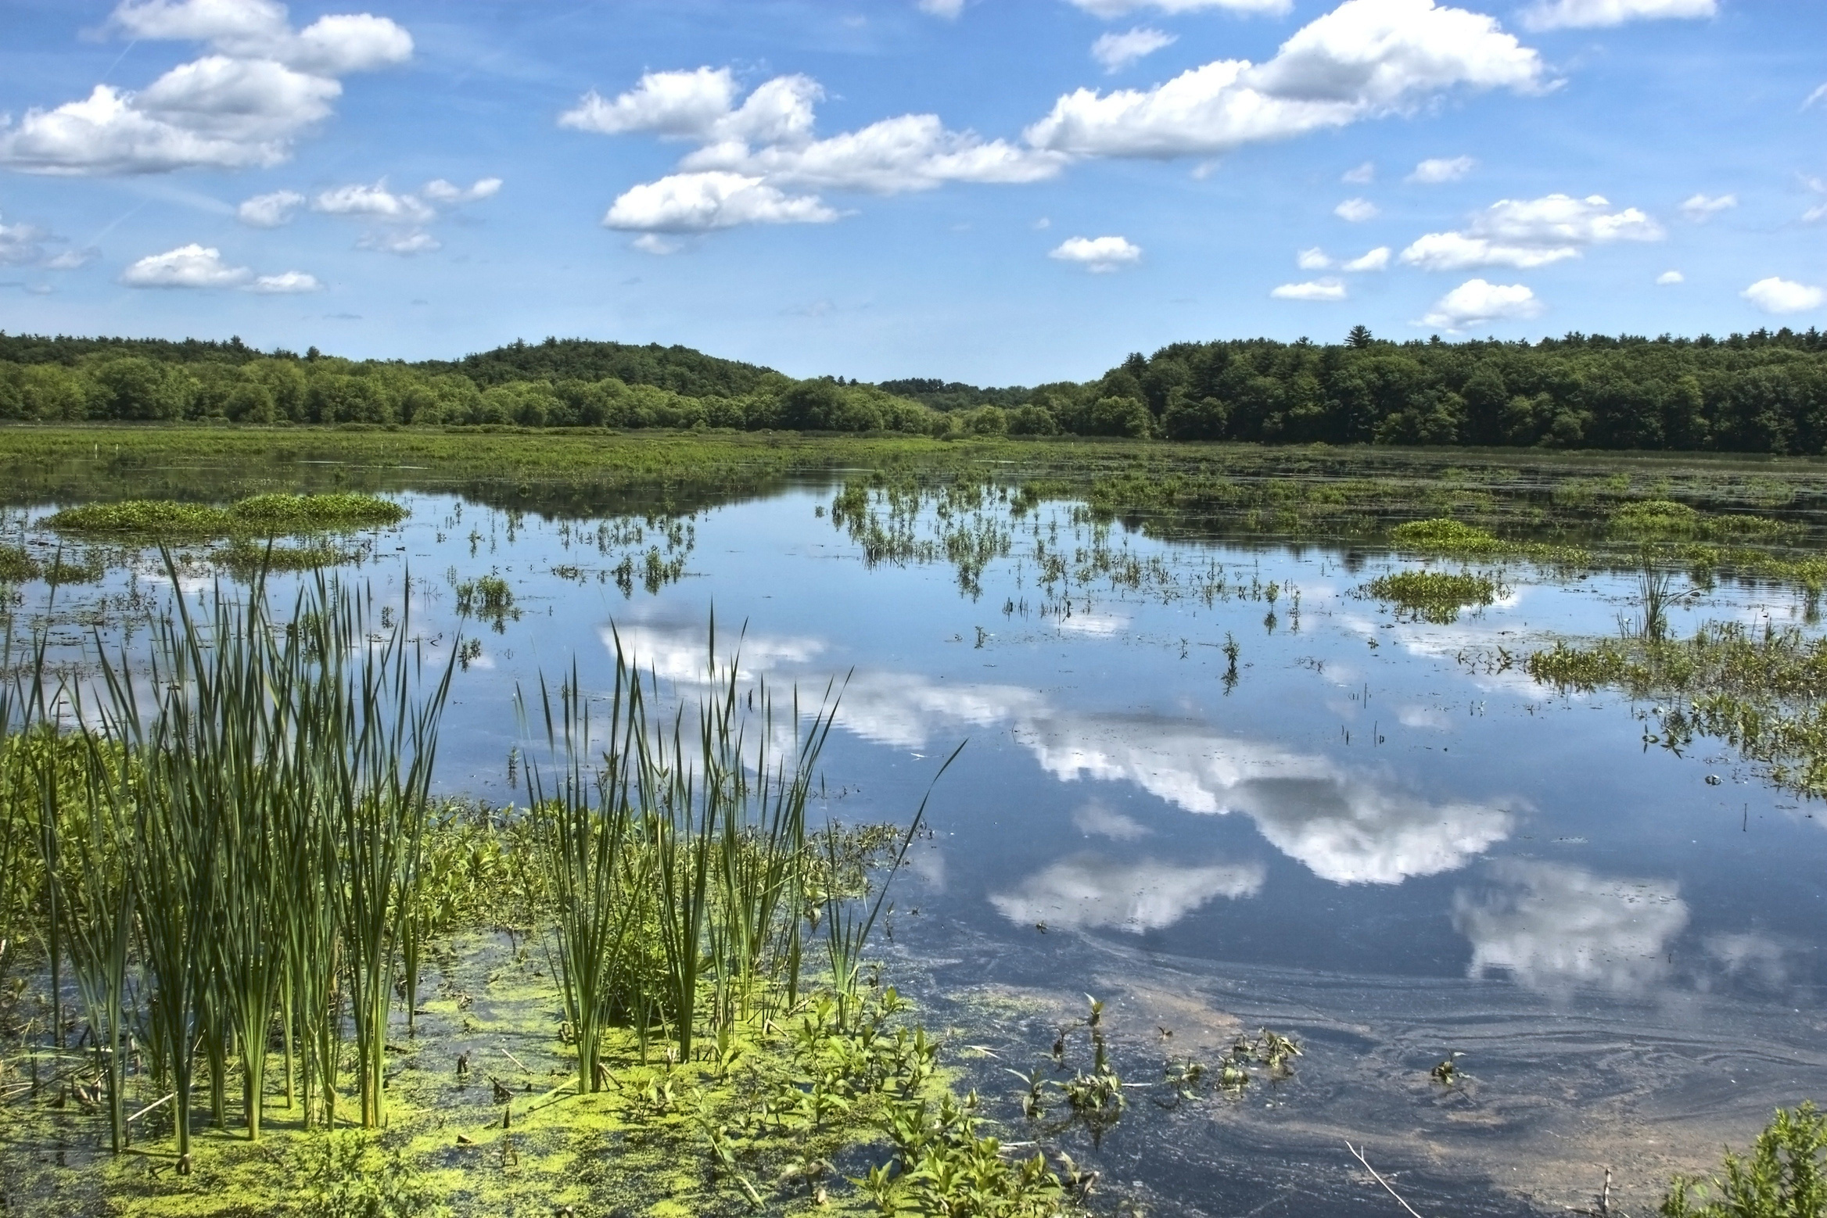
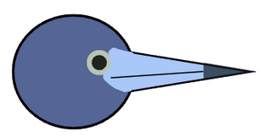



Contributions of geographically isolated wetlands to bird biodiversity across the conterminous United States
Jackson Barratt Heitmann, Brittany M. Mason, and Corey T. Callaghan
Fort Lauderdale Research Center, University of Florida

Slide 2
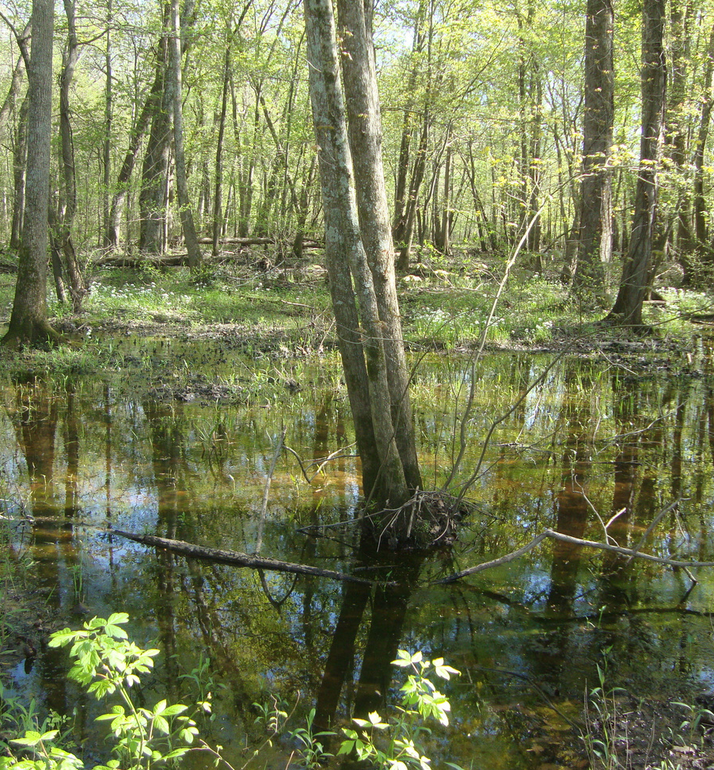
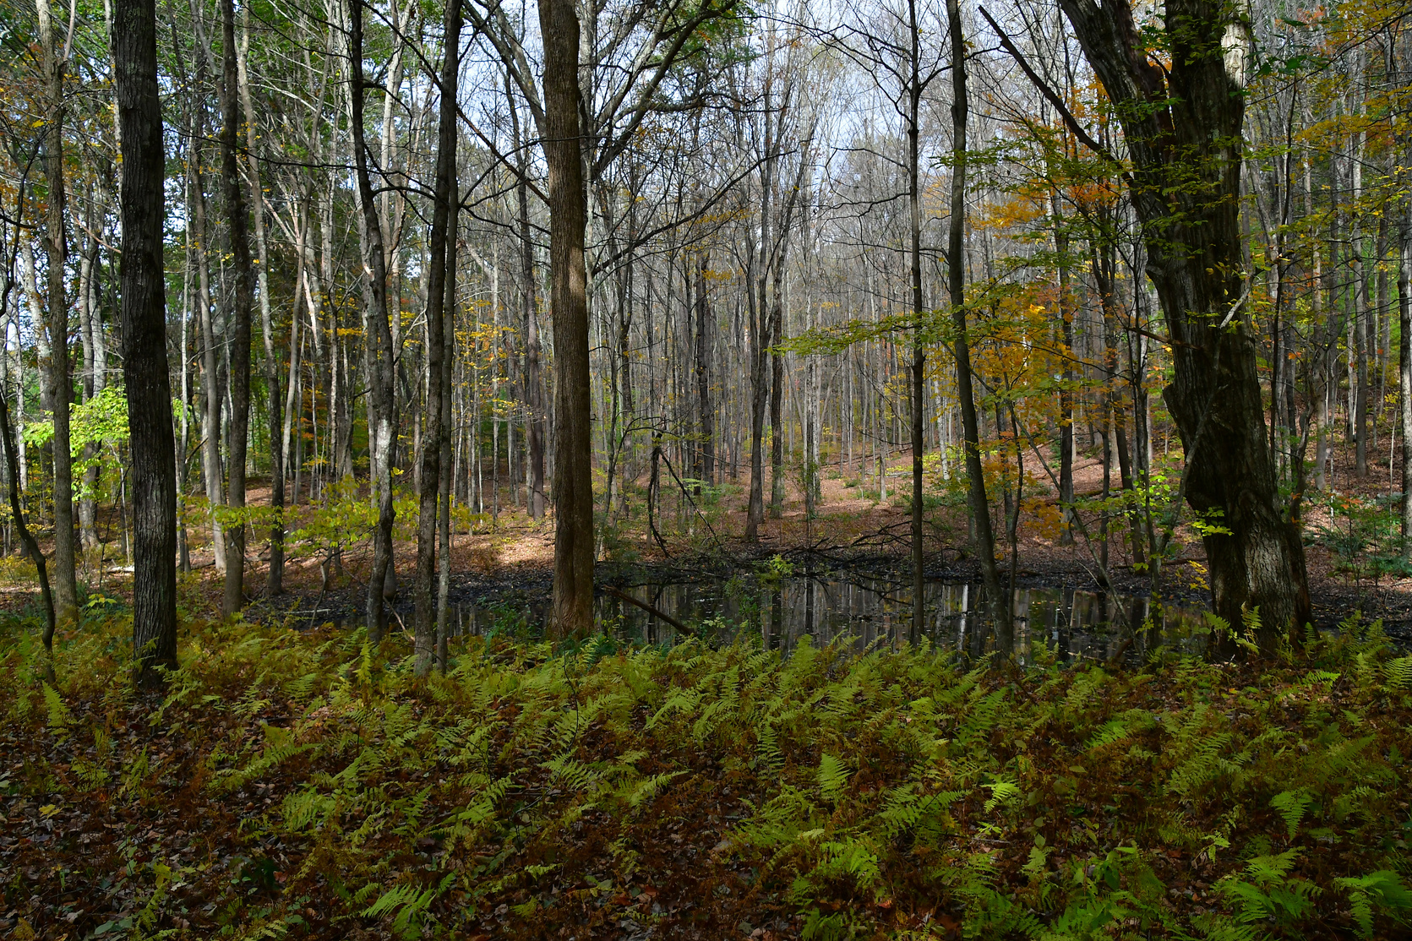
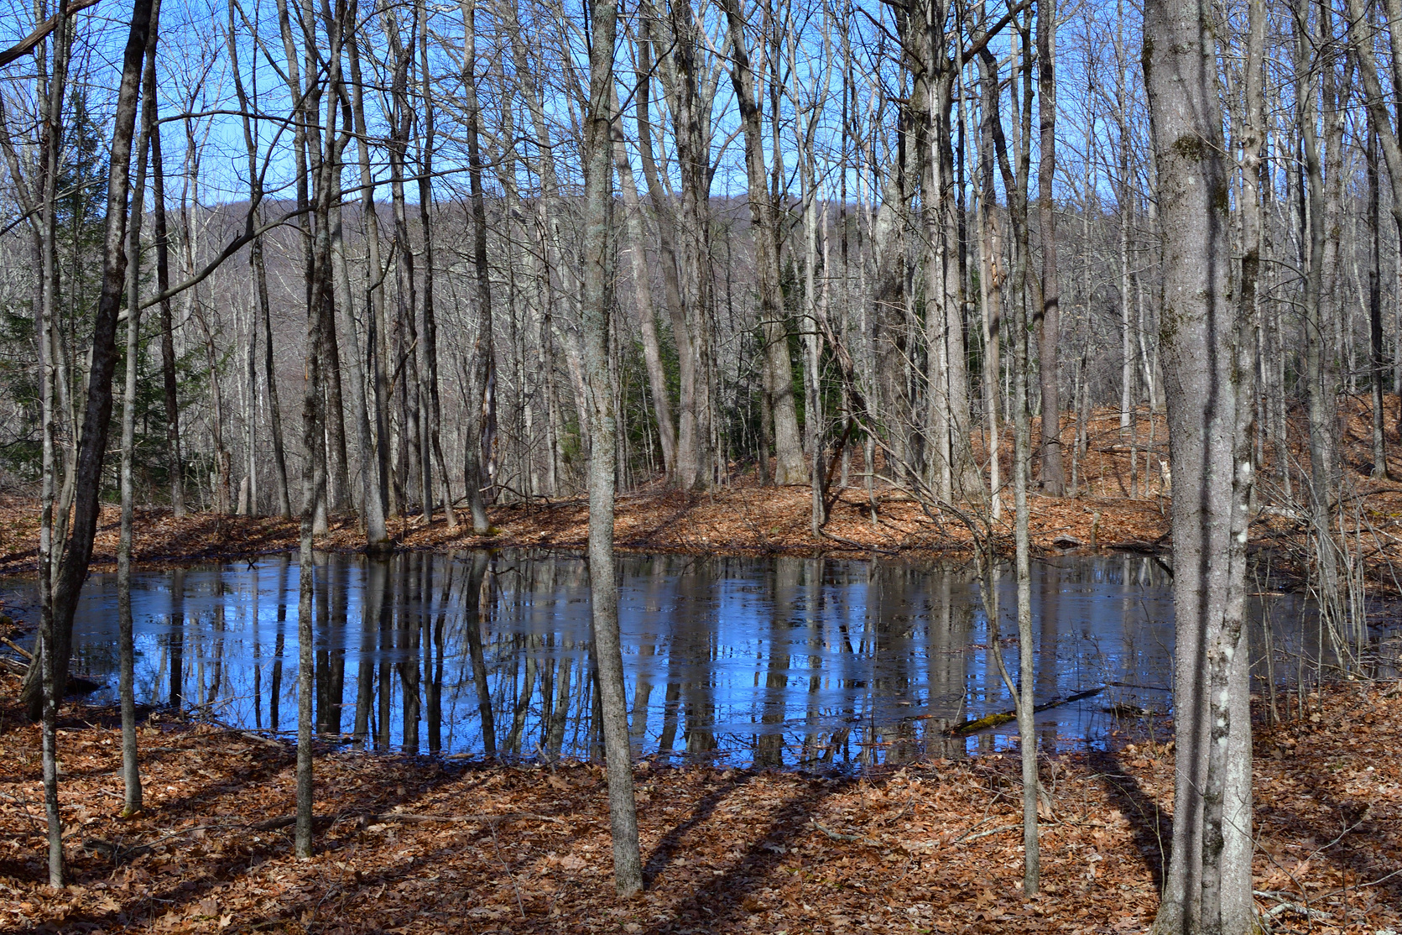
What are Geographically Isolated Wetlands?
Wetlands with no surface water connection (at least part of the year)
Characterized by variable: hydrology, vegetation, and area

Slide 3

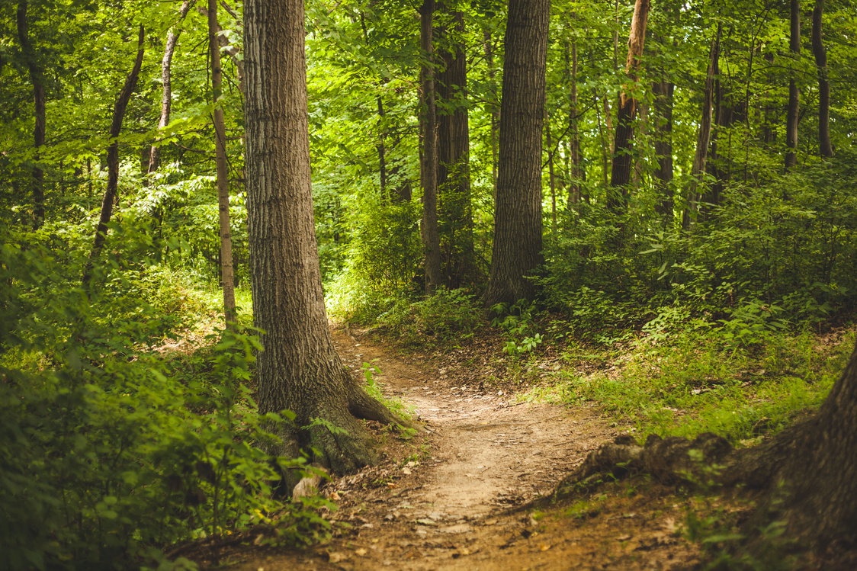
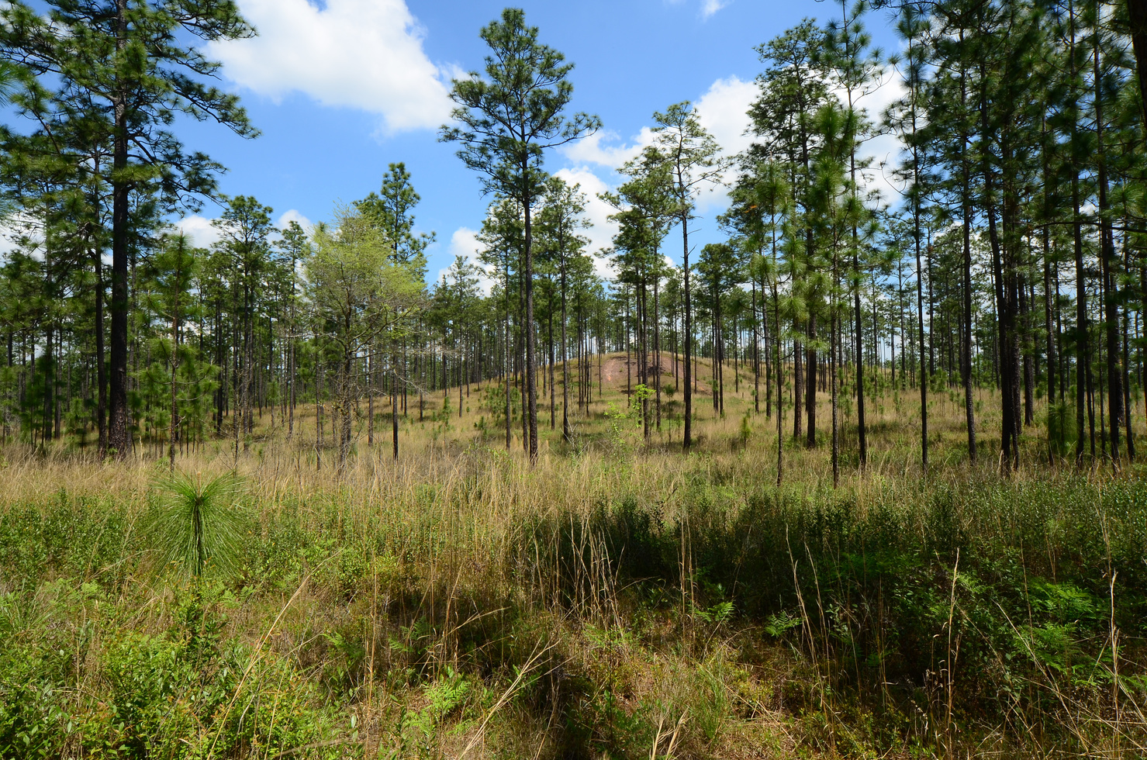
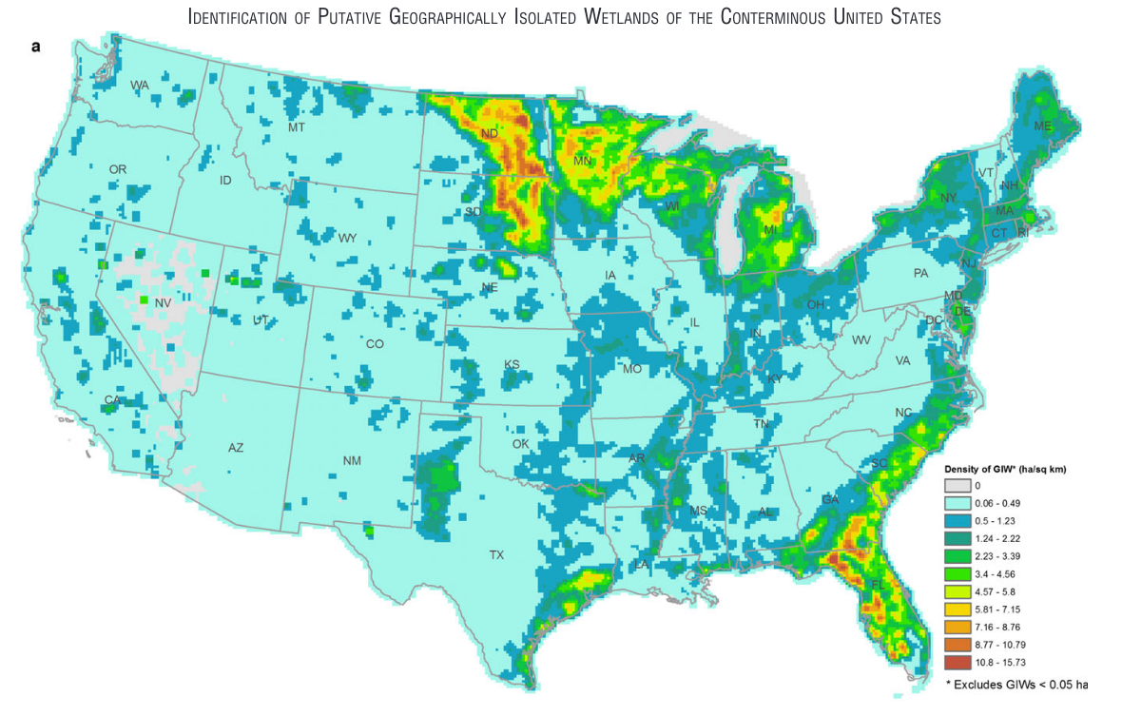
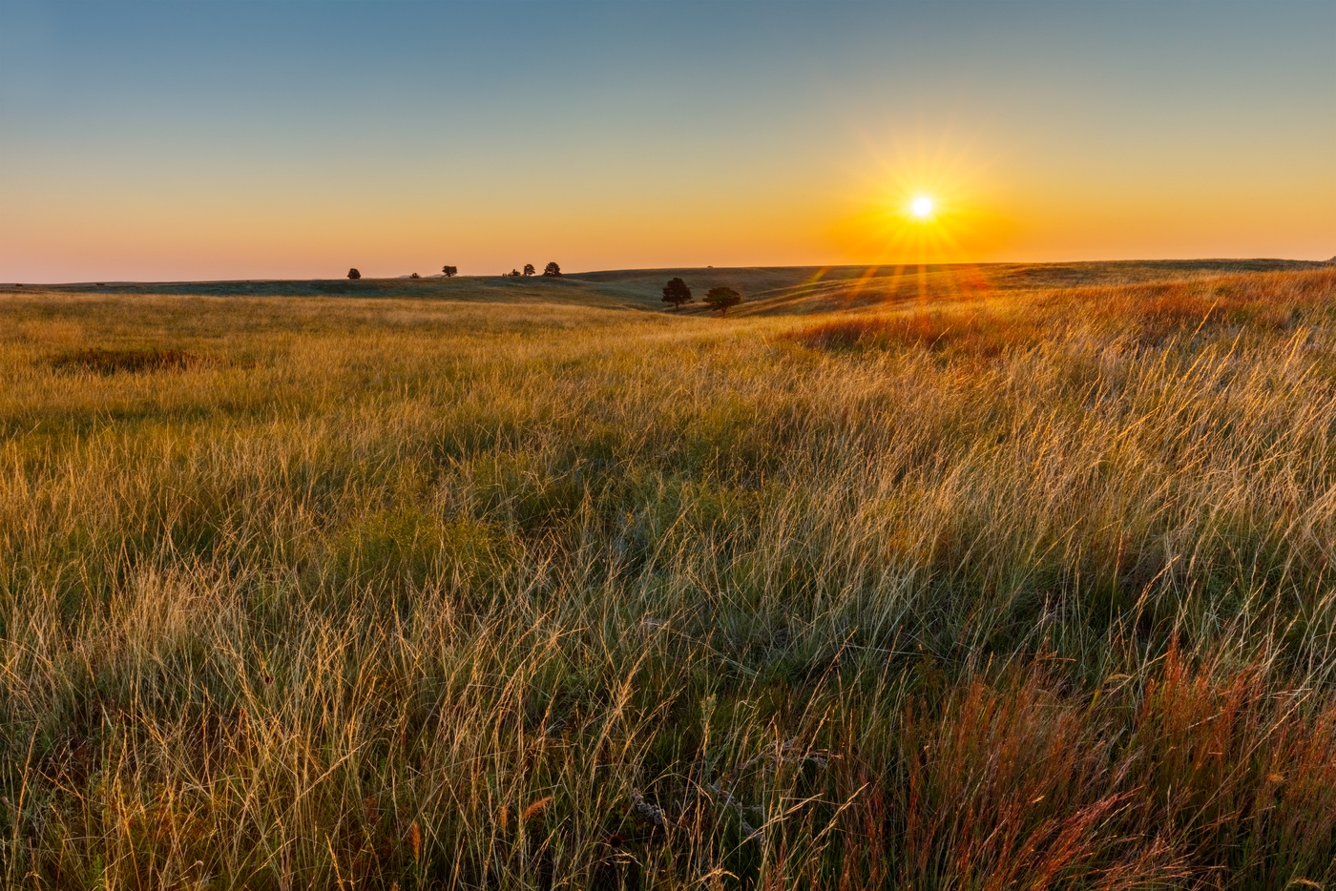
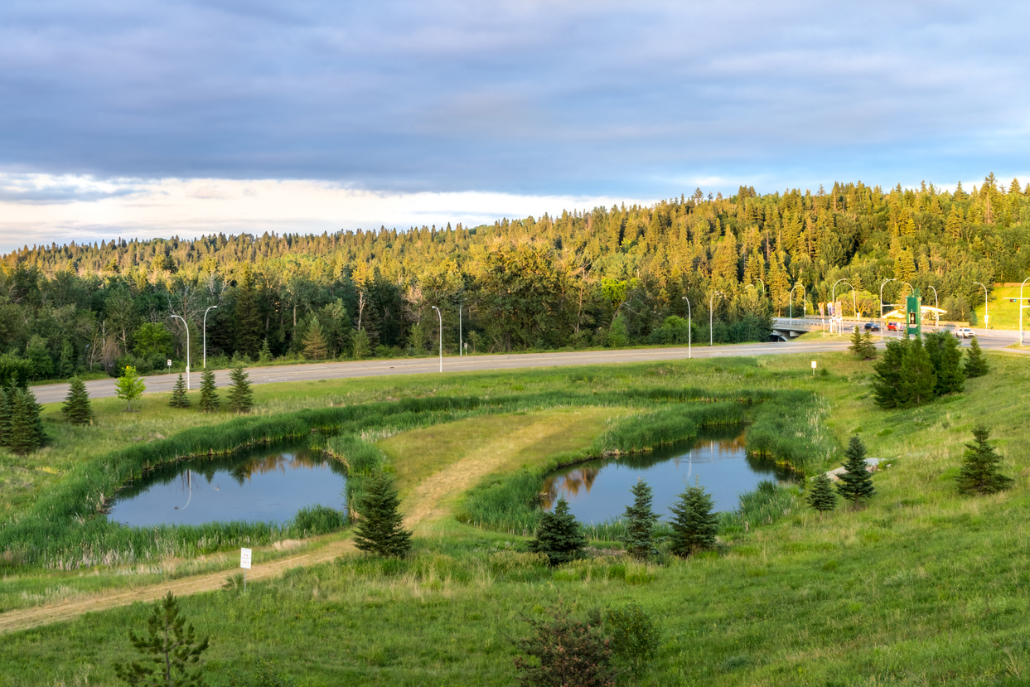
Where are they found?
Hardwood forest; Prairie; Pine Savanna; and Urban areas
Continental Distribution with many names [ie. Carolina Bays, Prairie Potholes, Vernal Pools, etc.]
(Lane and D’Amico 2016)

Slide 4
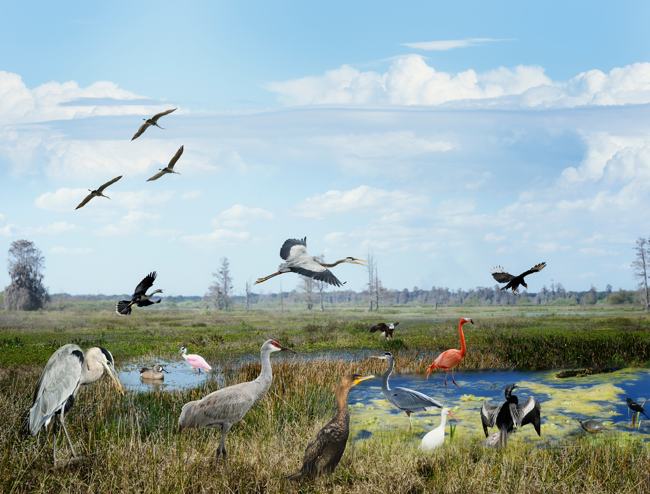
What do we know about Birds in Isolated Wetlands?
Evidence species richness is higher in wetlands than surrounding uplands.
(Barratt Heitmann et al. 2024, Riffell et al. 2006)
Species richness is higher in urban wetlands compared to rural ones.
(McKinney and Paton 2009)
But, we don’t know how these affect different functional groups of birds...
Or, if these signals are consistent spatially…

Slide 5



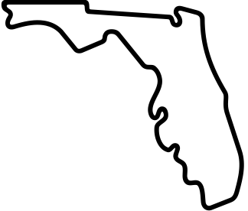
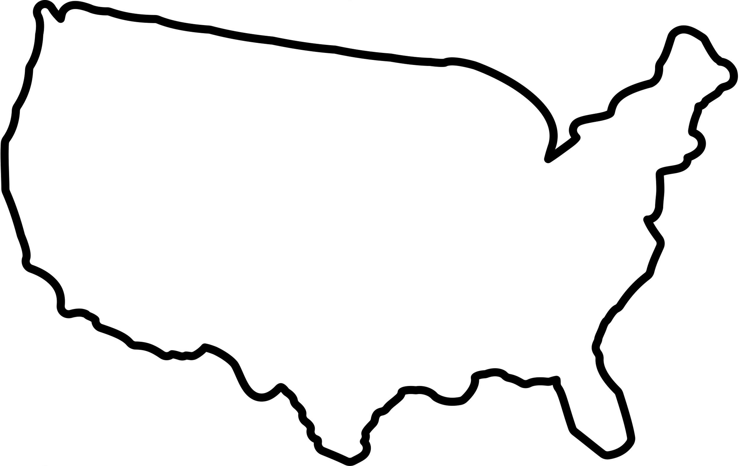


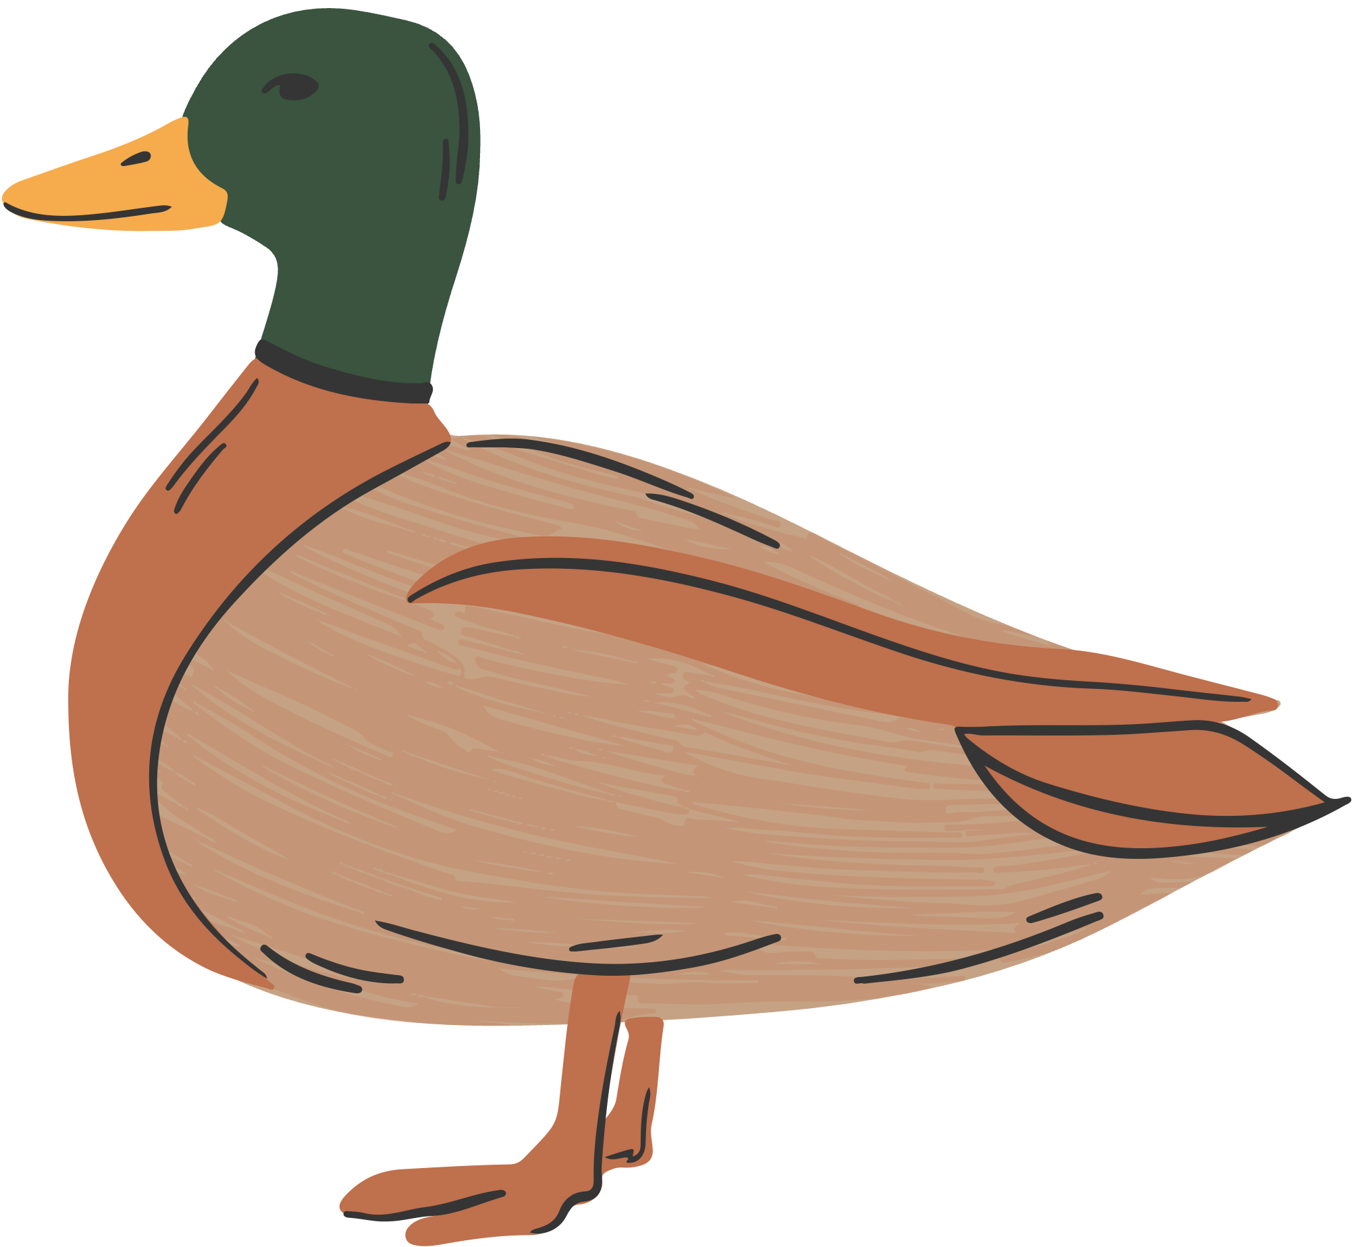
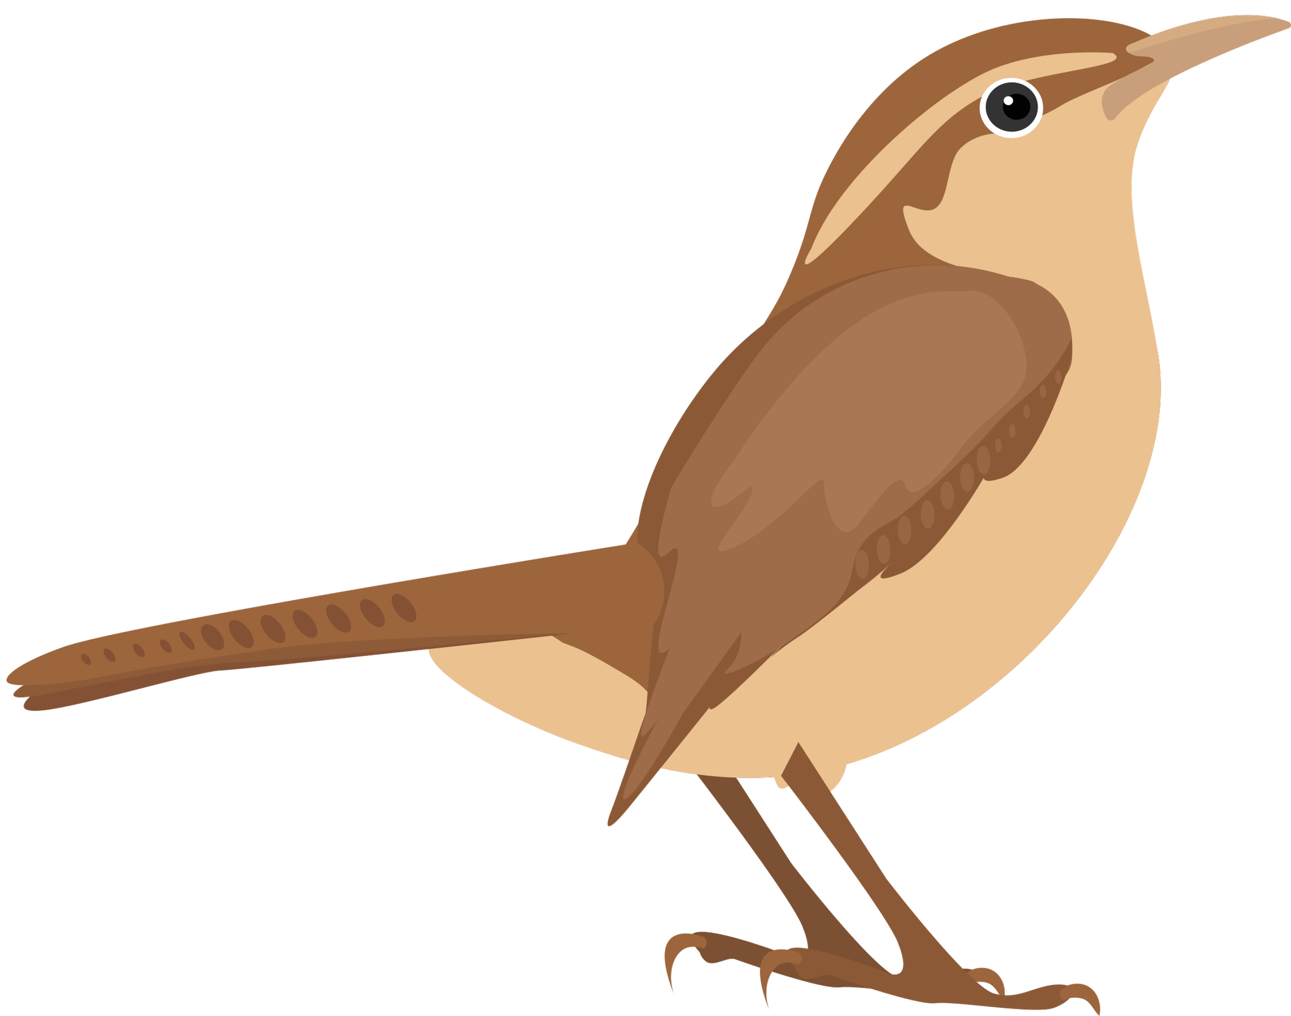
What gaps are we trying to fill?
1. Does wetland area impact species richness?
Local scale (wetland)
2. How do local and landscape land cover impact species richness and functional groups in these systems?
Landscape scale (25km)
Tree
Built
Water
Flooded Vegetation
3. Is there species turnover
(β-diversity) between wetlands at multiple spatial scales?

Slide 6
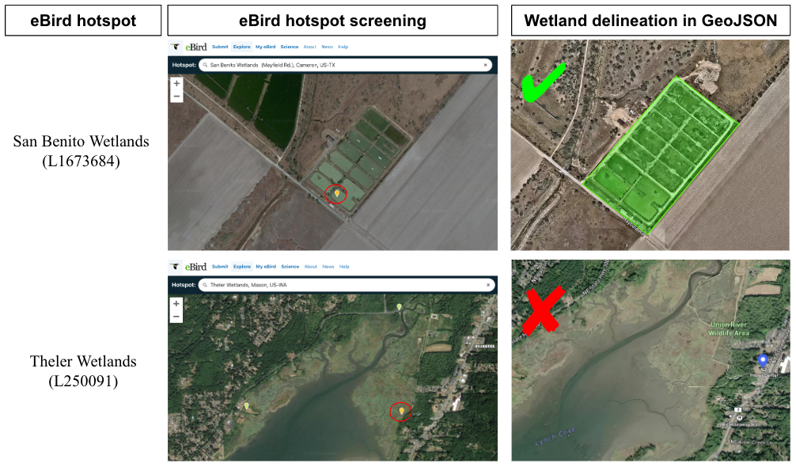
Integrating 207 wetlands with eBird hotspots across the conterminous United States

Slide 7
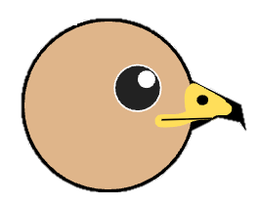
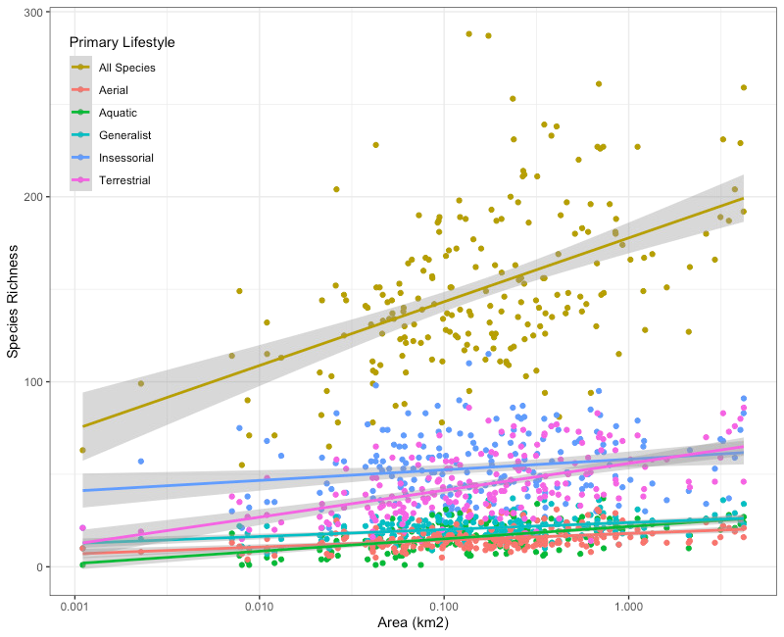
Objective 1: Species Richness Increases with Wetland Area
We found that species richness increases as wetland area increases.
This was most pronounced for Terrestrial and aquatic primary lifestyles.
Island Biogeography Theory wins again (!)
But, what about land cover impacts?

Slide 8
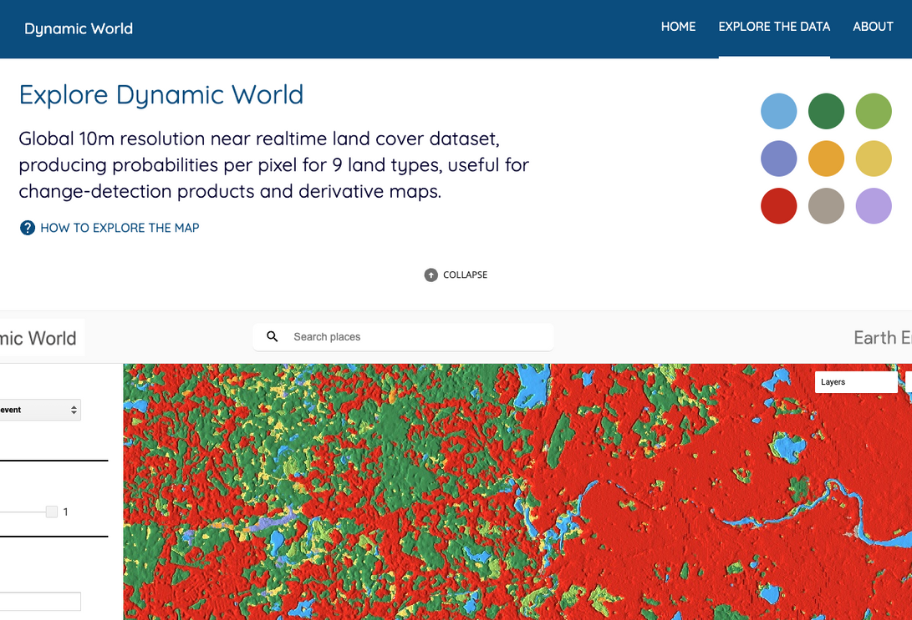


Gathering land cover data from Google Earth Engine, and calculating species richness from eBird.
eBird Hotspot ID
Species Richness
Land Cover
Calculating overall species richness at each eBird hotspot, as well as species richness of 5 different functional groups (Tobias et al. 2022).
Generalized Linear Model (6 of them)

Slide 9
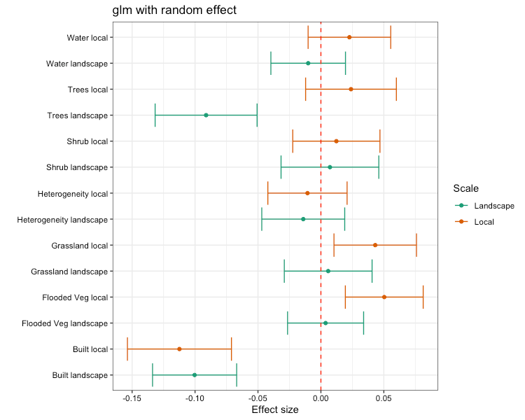

Objective 2: Built area reduces species richness, flooded vegetation increases species richness.
Built land area reduces richness at multiple scales.
Trees reduced species richness, likely due to environmental filtering in the Temperate Forests of the Northeast.
Flooded vegetation and grass cover promote richness at the local scale.
But, what about the functional group richness?

Slide 10
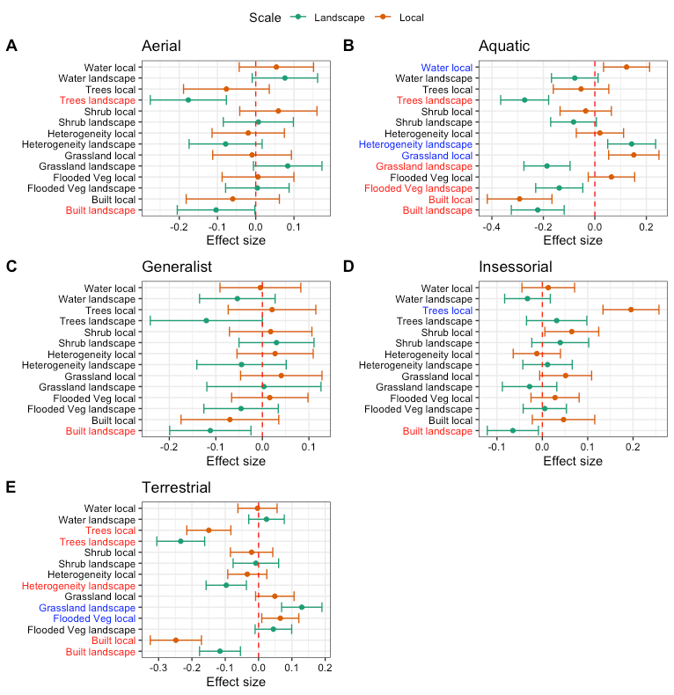

Objective 2 (cont.): Land cover impacts functional group richness differently
All species respond negatively to built land area, at multiple scales.
Aquatic species richness responds positively to water and grassland cover locally, heterogeneity in landscape.
Terrestrial species richness positively associated with grassland and flooded vegetation cover.
Tell me about the species turnover!

Slide 11
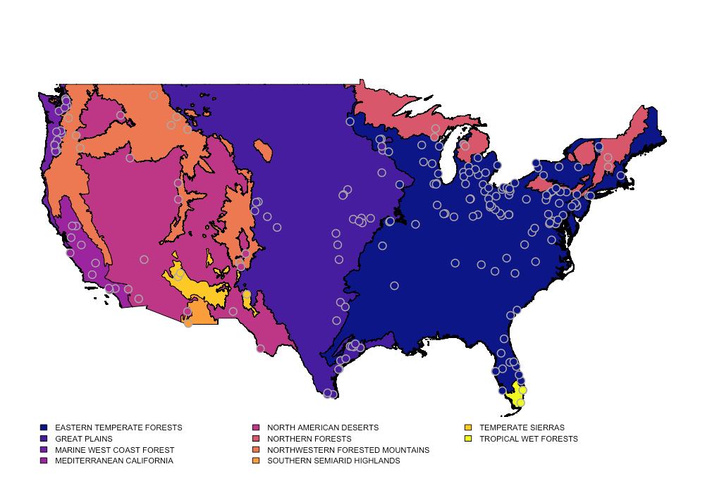
Map of all n=207 isolated wetlands by EPA Level I ecoregion
Are there changes in the bird community within wetlands, between them, or between ecoregions?

Slide 12
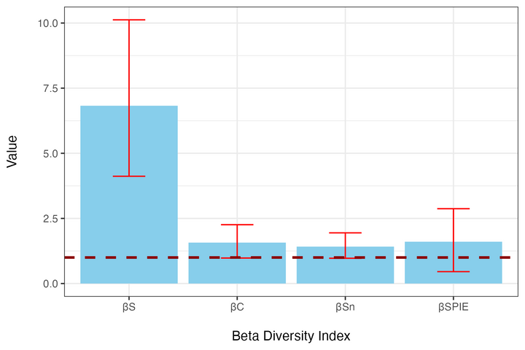
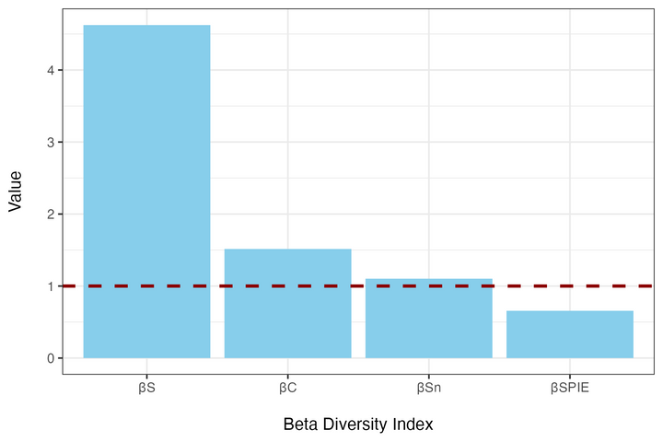
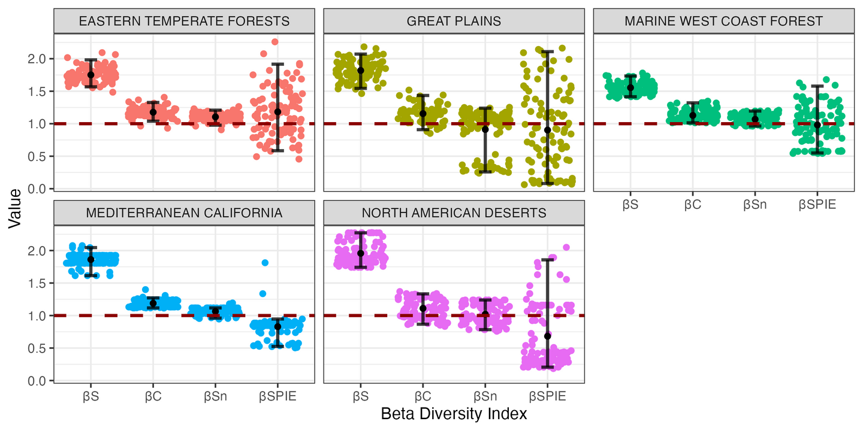

Wetland
Continental
Objective 3: β-diversity is consistent across spatial scales
Ecoregion
βS values were quite high across all sampling scales, and βC values were generally low.
Species turnover (β) is not due to aggregation changes, but rather random sampling (i.e., changes in abundance of species and in the identify of rare species).

Slide 13
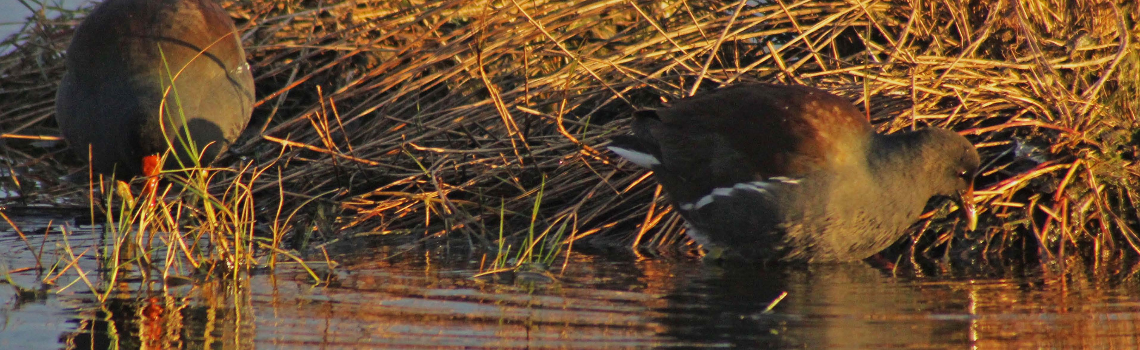

What does this mean for birds in GIWs?
Terrestrial and aquatic species richness drive the species area relationship
Larger wetlands likely visited by a greater number of larger-bodied species compared to relatively smaller insessorial and aerial species.
Landscape variables are responsible for negative trends in richness, local variables responsible for positive predictors of species richness.
GIWs across the continent have low species turnover due to aggregation, but have very high diversity

Slide 14
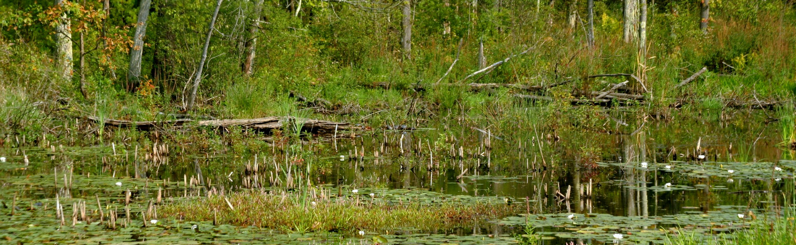
What can managers and conservation professionals do with this information?
Prioritize preservation/restoration/creation of larger wetlands
Identify wetlands for conservation across their continental distribution, for high bird biodiversity value
Incorporate flooded vegetation in created wetlands and restoration of natural wetlands.

Slide 15
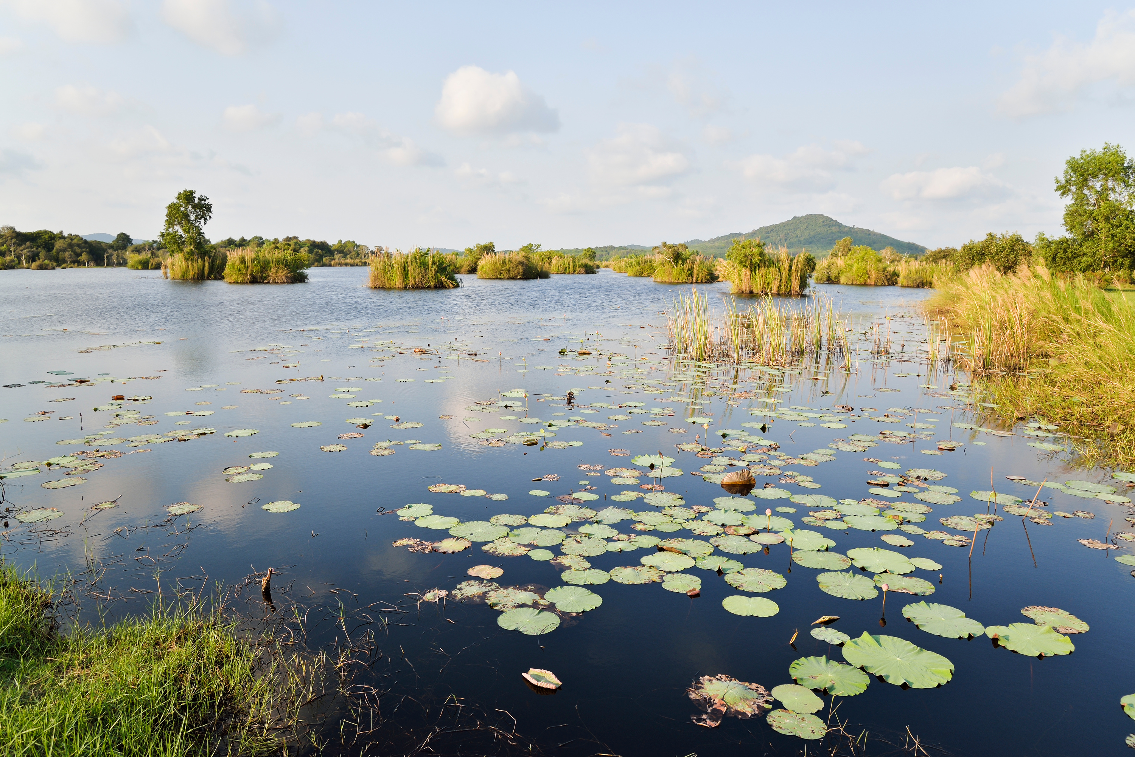

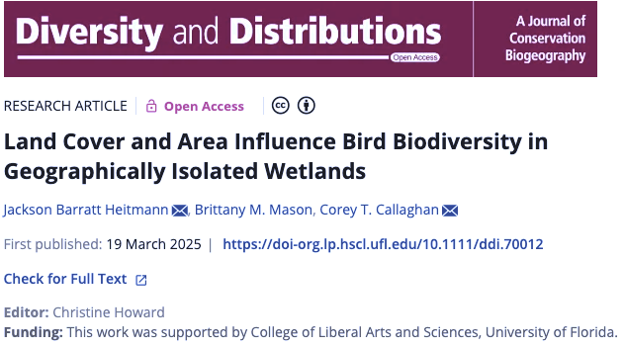
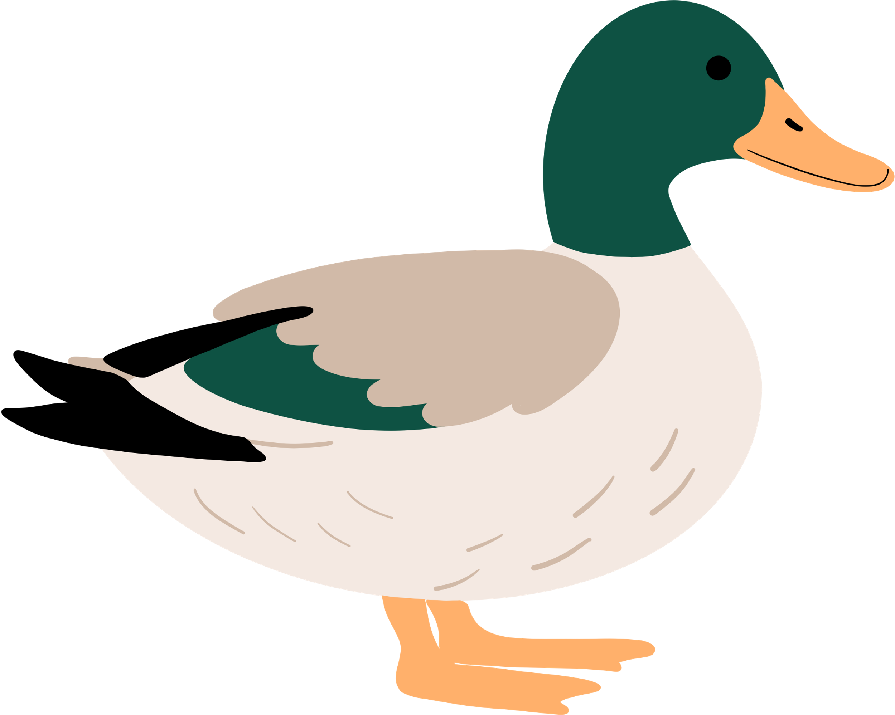


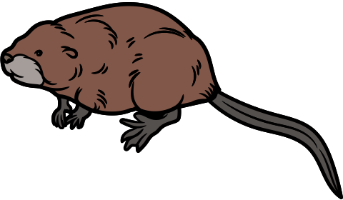
Thanks to everyone who contributes to eBird.
Special thanks to my collaborators Brittany Mason and Corey T. Callaghan
Questions: j.barrattheitman@ufl.edu
Fun Facts:
Spark bird was the Red-bellied Woodpecker.
Favorite bands are Death Cab for Cutie, Vampire Weekend, and all things Bob.
Will talk all things running, cycling, and Wingspan.

